Slide 1
Recommendation Algorithms
Lecturer: Dr. Bo Yuan
E-mail: yuanb@sz.tsinghua.edu.cn

Slide 2
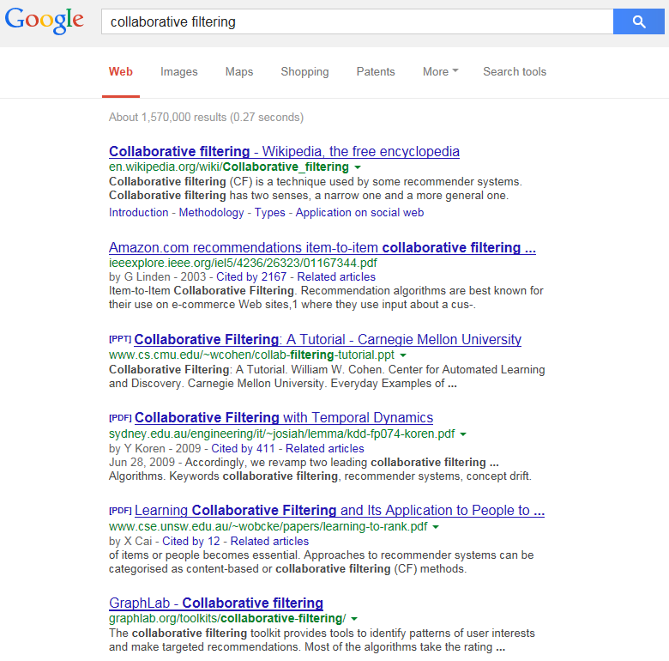
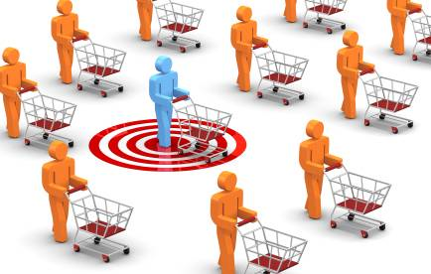
Overview
TF-IDF
Vector Space Model
Latent Semantic Analysis
PageRank
Collaborative Filtering
more relevant
less relevant

Slide 3
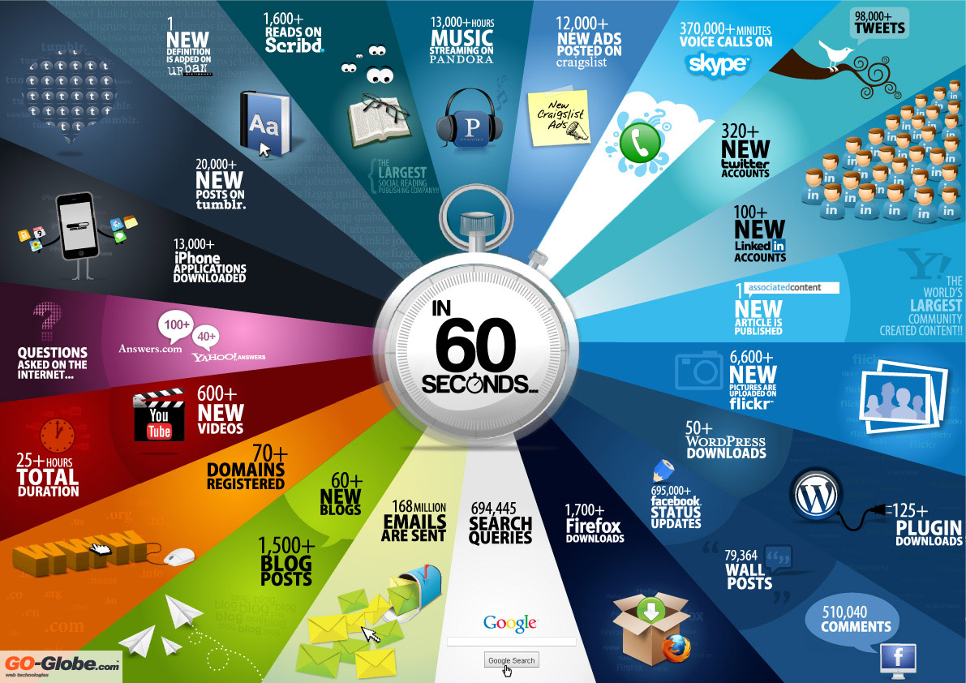

Slide 4
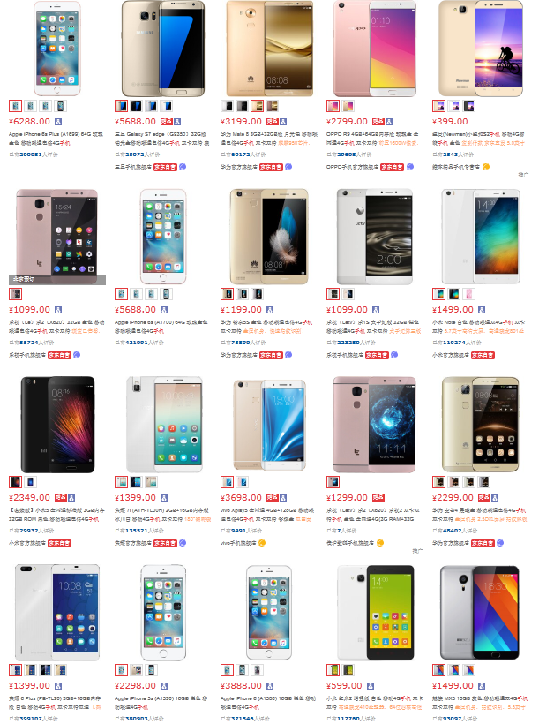
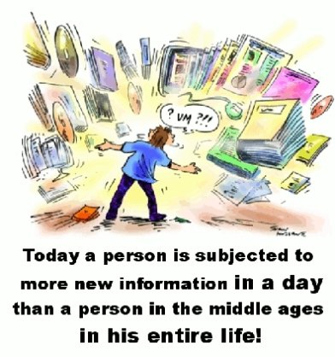
Information Overload

Slide 5



Recommendation Systems
A system that predicts a user’s rating or preference to an item.
Help people discover interesting or informative stuff that they wouldn't have thought to search for.
One of the most influential applications of data mining.
Content-Based Filtering
Focuses on the characteristics of items.
Recommends items similar to those that a user liked in the past.
Collaborative Filtering
Predicts what users will like based on their similarity to other users.
Similar to asking the opinions of friends.
Does not rely on machine analysable contents.

Slide 6
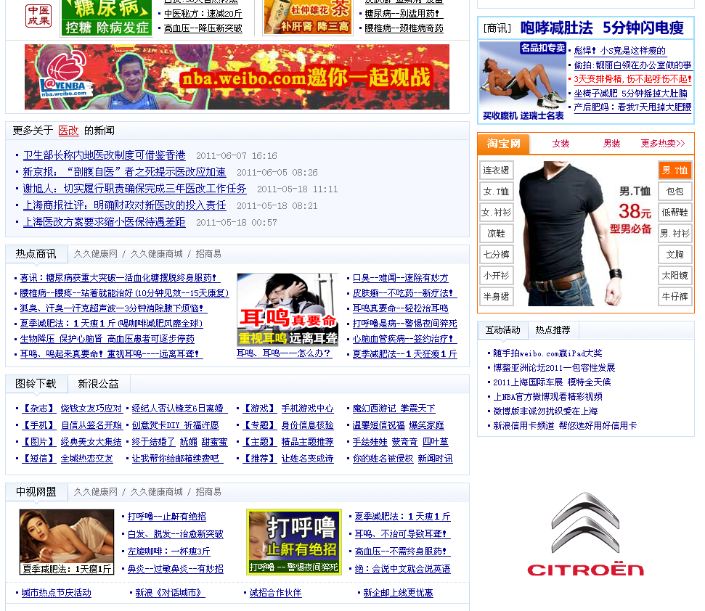
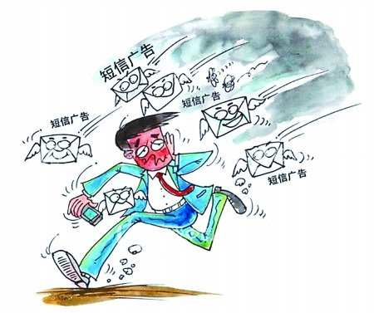
Junk Advertisement
Your Trash Can Be Someone's Treasure!

Slide 7




Targeted Advertisement
Ads Engine
Knowledge Base
What are you browsing?
Who are you?
Previous Record
Where are you?

Slide 8
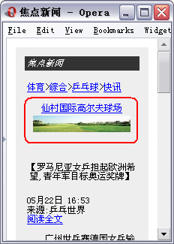
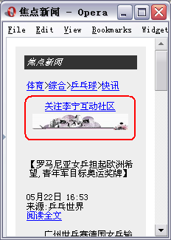
Mobile Advertisement Platform

Slide 9

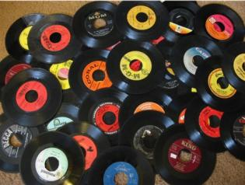
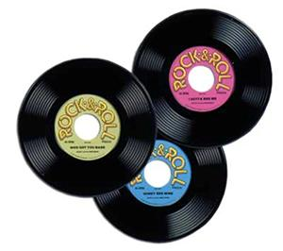

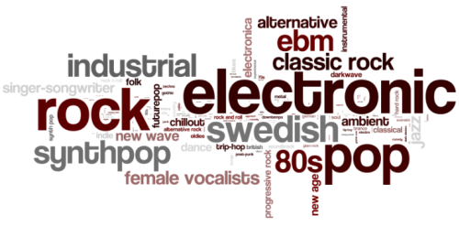
Music Recommendation
Keywords
Preference
Popularity
Ranking
Feedback (rating, like vs. dislike)

Slide 10


Slide 11

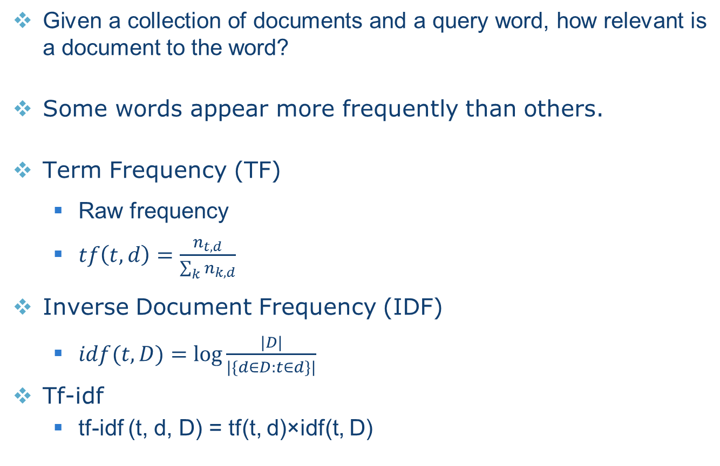
Tf-idf
Given a collection of documents and a query word, how relevant is a document to the word?
Some words appear more frequently than others.
Term Frequency (TF)
Raw frequency
$tf\left(t,d\right)=\frac{n_{t,d}}{\sum_{k}{n_{k,d}}}$
Inverse Document Frequency (IDF)
$idf(t, D)=\log{\frac{|D|}{|\{d∈D:t∈d\}|}}$
Tf-idf
tf-idf (t, d, D) = tf(t, d)×idf(t, D)
Notes:
Tf-idf：tf*idf
Tf：某个词在文档中出现频率
Idf：某个词出现的文档在所有文档中的比例的倒数，如果某个词在其他文档中出现的比较少，说明很有特点。
e.g. 单词the，虽然TF很高，但IDF近似于0，则TF-IDF很小，虽然出现很频繁，但是它没有什么特点。

Slide 12
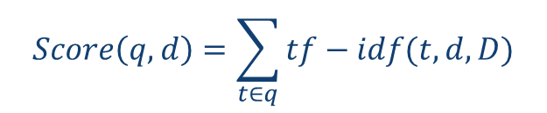
Tf-idf
Multiple query words
$$Score\left(q,d\right)=\sum_{t∈q}{tf−idf(t,d,D)}$$
 | Doc 1 | Doc 2 | Doc 3 | Doc 4
the | 20 | 10 | 15 | 8
best | 0 | 1 | 0 | 2
car | 3 | 5 | 0 | 0
Term-Document Matrix

Slide 13
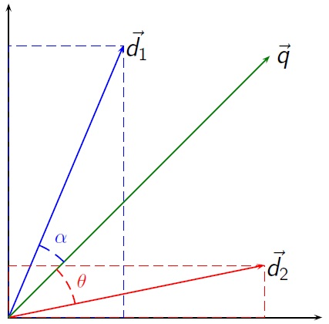
Vector Space Model
An algebraic model for representing text documents as vectors.
Cosine Similarity
Notes:
P和q如果一样，→ 夹角=0 → cos = 1，cos相似度为1

Slide 14

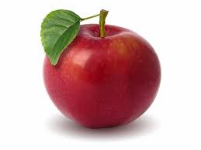
Vector Space Model
Synonymy
Different words, same meaning
Car, Vehicle, Automobile
Small cosine values → unrelated
Poor recall
Polysemy
One word, different meanings
Apple Computer vs. Apple Juice
Large cosine values → related
Poor precision
Let’s work in a more informative space.
Merge dimensions with similar meanings.
Singular Value Decomposition

Slide 15
Latent Semantic Analysis
Notes:
矩阵的奇异值分解（SVD）
T和D是正交矩阵，S是对角阵
m: 单词个数
n: 文档个数
r: rank(X)表示矩阵的秩，是指最大的不为零的子式的行数或列数
T：XX^{T}的特征矩阵
S：X的特征值组成的一个对角矩阵
D：X^{T}X的特征矩阵
假设X矩阵有r个特征值，那么我们把r个特征值从大到小排列，前k个保留，后面r-k个置零

Slide 16
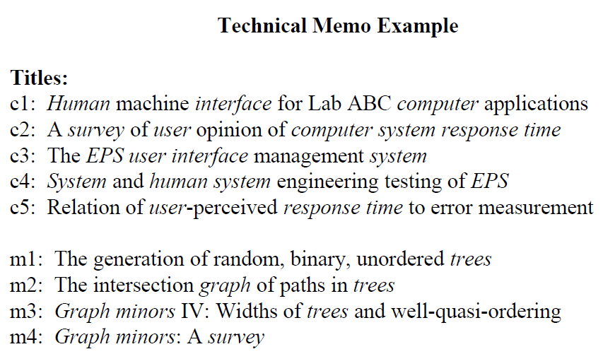
Latent Semantic Analysis

Slide 17
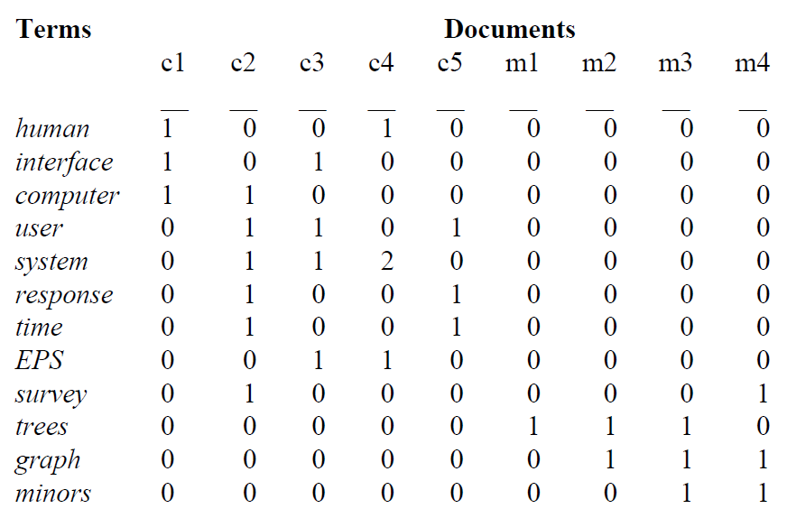
Original Matrix
Notes:
构建初始矩阵X，行表示单词，列表示文档

Slide 18
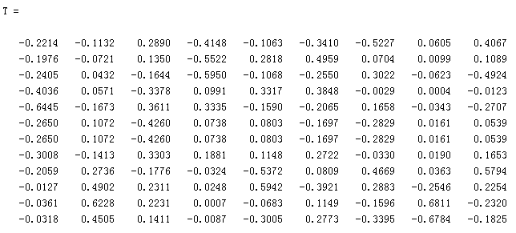
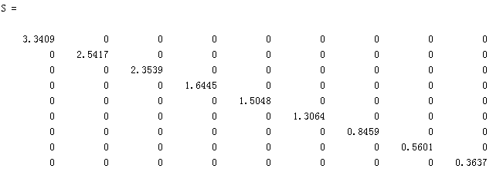
Decomposition
Notes:
矩阵SVD分解（即奇异值分解）可得T、S、D

Slide 19
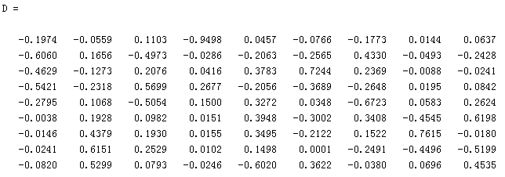
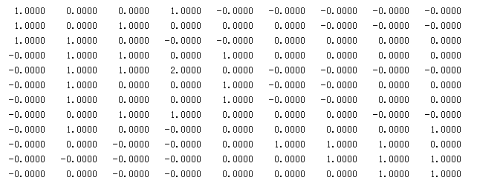
Decomposition

Slide 20
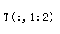
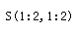
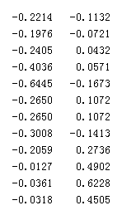
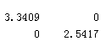
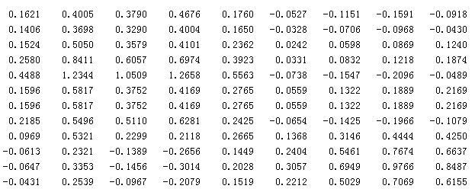
Rank K Approximation
K=2
Notes:
对T、S、D分别降维到2维，得到T₂，S₂，D₂
然后再乘回去，得到X-hat=T₂ * S₂ * D₂^{T}
可以证明X-hat和X不同，但是很接近，误差小

Slide 21
Items in 2D Space
Notes:
在二维空间中，某些单词的特别近（夹角很小，cos相似度）
对于每一个单词（行向量）t_{i，} t_{i}-hat是t_{i}到低维空间的映射，
例如，k=2时，每个单词对应的t_{i}-hat都有2个维度，其值分别对应上面图中的X轴和Y轴
t_{j}-hat = S₂⁻¹ D₂^{T}t_{j}
上面公式得到的是列矩阵，即每一列是一个term
单词t_{j}和t_{q}之间的关系，可以看S’ t_{j}-hat和S’ t_{q}-hat两个向量之间的距离，注意，这里距离不是欧式距离，而是cos相似度，即到原点的夹角

Slide 22
Documents in 2D Space
Notes:
对于每一个文档（列向量）d_{j}，d_{j}-hat是d_{j}到低维空间的映射
d_{j}-hat = S₂⁻¹ T₂^{T}d_{j}
文档d_{j}和d_{q}之间的关系，可以看S’ d_{j}-hat和S’ d_{q}-hat两个向量之间的cos相似度

Slide 23
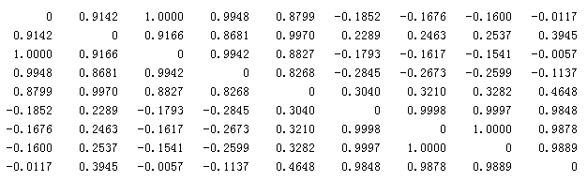
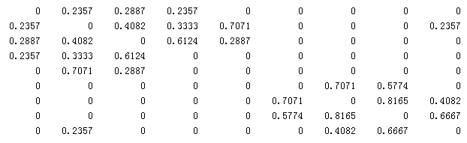
Document Cosine Similarity
Transformed
Original
Notes:
Transformed：X‘每个列和其他列计算cos相似度
Original：X的每个列和其他列计算cos相似度

Slide 24
Query
C
M
Cosine Similarity to Current Documents
Notes:
对每一个查询q, 将q降维到低维空间，得到q-hat
如例子中，一个新的文档q，变换后，再去和现有的文档，计算cos相关系数

Slide 26
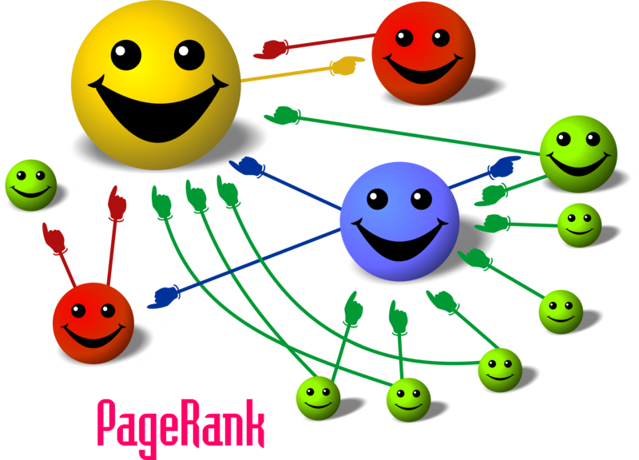
Linked Documents

Slide 27
PageRank
Given a set of hyperlinked documents, how to evaluate the relative importance of each document?
A hyperlink to a page counts as a vote of support.
The importance of vote from a page depends on its own PageRank and the number of outbound links.
The PageRank of a page is determined by the number and PageRank metric of all pages that link to it.
The outbound links of a page do not affect its PageRank value.
Difficult to manipulate inbound links.
A key factor determining a page’s ranking in the search results of Google.

Slide 28
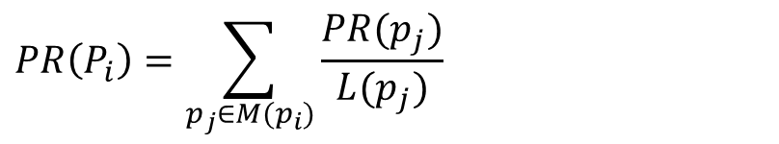
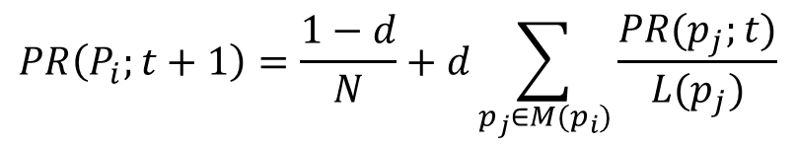
PageRank
A
B
$$PR\left(P_{i}\right)=\sum_{p_{j}∈M(p_{i})}{\frac{PR(p_{j})}{L(p_{j})}}$$
C
D
$$PR\left(P_{i};t+1\right)=\frac{1−d}{N}+d\sum_{p_{j}∈M(p_{i})}{\frac{PR(p_{j};t)}{L(p_{j})}}$$
d: damping factor (0.85)
Notes:
L(P): p点的outlink数
M(P)：outlink目标点为p点的那些点
可以证明，所有网页的pageRank值之和，在任何时刻都是1

Slide 29
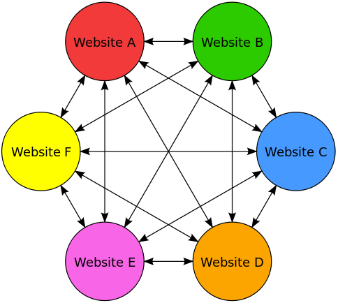
PageRank
Notes:
用向量和矩阵表达的pageRank公式
假设迭代公式是收敛的，则当t足够大时，t和t+1时刻，R是相等的，则可以从上面的R的迭代方程式，解出红框中的R的公式

Slide 30
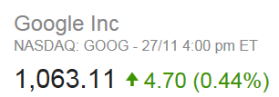
Monetary Success
Stanford University received 1.8 million shares for allowing Google Inc. to use this technique.
Sergey Brin: US$ 37 billion (2016)
Larry Page: US$ 38 billion (2016)
Made totally US$ 336 million in return by 2005.
Within two years after Google’s IPO
Around US$ 187 per share
How about if the shares are sold today?
Current Endowment: US$ 22 billion
One of the largest single academic licensing transactions
Cloning Technology: US$ 225 million in royalties

Slide 32

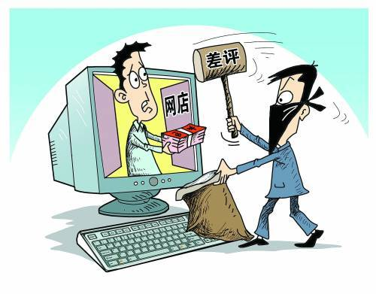
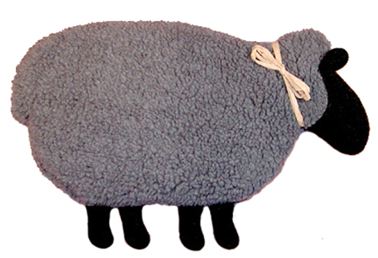

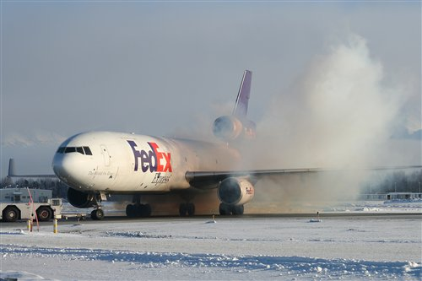
Collaborative Filtering
Core Idea:
People get the best recommendation from others with similar tastes.
Workflow:
Creates a rating or purchase matrix.
Finds similar people by matching their ratings.
Recommends items that similar people rate highly.
Memory-Based CF
User-Based vs. Item-Based
Model-Based CF
Things to know:
Gray Sheep
Shilling Attack
Cold Start

Slide 33
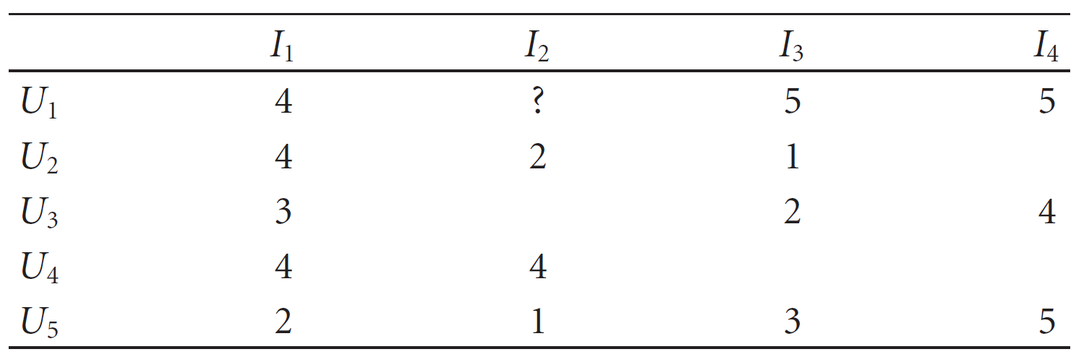
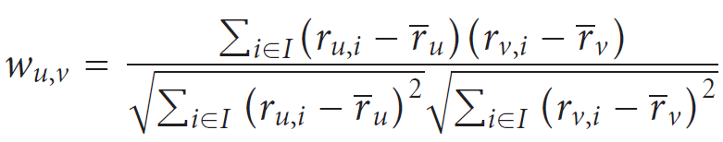
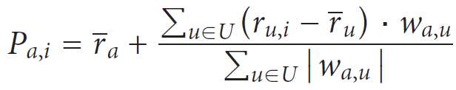
User-Based CF
Notes:
a：用户a
i：商品i
r(u,i)：用户u对商品i打的分
ṝ(u)：用户u对所有商品打分的平均分
w(u,v)：用户u和v的相关性系数
P(a,i)：预测用户a对商品i的分数
注意，计算出P后，还要和该用户的打分的平均分比较，才能判断该用户是否喜欢该商品，因为不同用户的打分尺度可能不一样。

Slide 34
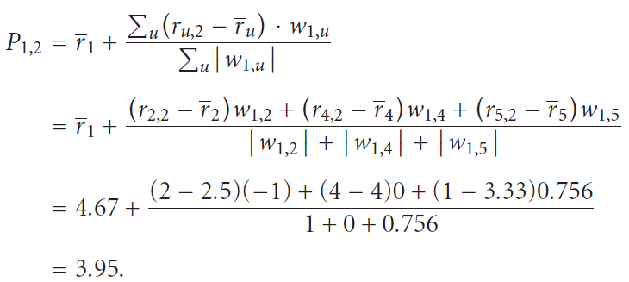
User-Based CF
Notes:
3.95 < 4.67(平均分）

Slide 35
Item-Based CF
U: Users that have rated both i and j.
I: All items that have been rated by User a.
Notes:
多种计算公式，思想是一样的，具体实现不同

Slide 36
Item-Based CF
U: Users that have rated i.
U: Users that have rated both i and j.
I: Items that the user has rated and have dev values.

Slide 37
Item-Based CF
Customer | Item 1 | Item 2 | Item 3
John | 5 | 3 | 2
Mark | 3 | 4 | Didn't rate it
Lucy | Didn't rate it | 2 | 5
Slope One

Slide 38
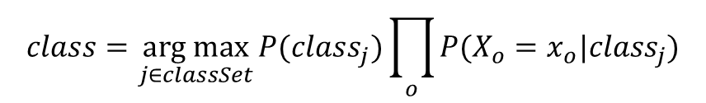
Model-Based CF
Class Label
Attributes
Training Samples
$$class=\underset{j∈classSet}{arg max}{P({class}_{j})\prod_{o}{P(X_{o}=x_{o}|{class}_{j})}}$$

Slide 39
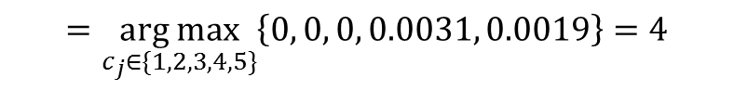
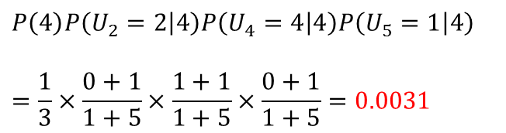
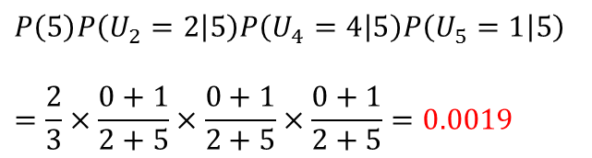
Model-Based CF
$$class=\underset{c_{j}∈\{1,2,3,4,5\}}{arg max}{P\left(c_{j}\right)P\left(U_{2}=2 | c_{j}\right)P\left(U_{4}=4|c_{j}\right)P(U_{5}=1|c_{j})}$$
$$=\underset{c_{j}∈\{1,2,3,4,5\}}{arg max}\left\{0, 0, 0, 0.0031, 0.0019\right\}=4$$
$$P\left(5\right)P\left(U_{2}=2 | 5\right)P\left(U_{4}=4 | 5\right)P\left(U_{5}=1 | 5\right)$$
$$=\frac{2}{3}×\frac{0+1}{2+5}×\frac{0+1}{2+5}×\frac{0+1}{2+5}=0.0019$$
$$P\left(4\right)P\left(U_{2}=2 | 4\right)P\left(U_{4}=4 | 4\right)P\left(U_{5}=1 | 4\right)$$
$$=\frac{1}{3}×\frac{0+1}{1+5}×\frac{1+1}{1+5}×\frac{0+1}{1+5}=0.0031$$

Slide 40
Model-Based CF
 | I₁ | I₂ | I₃ | I₄ | I₅
U₁ | Like | Dislike | Dislike |  | Like
U₂ | Dislike |  |  | Dislike | Dislike
U₃ |  | Like | Like |  | Like
Class Label | Like | Dislike | Like | Like | ?
 | I₁ | I₂ | I₃ | I₄ | I₅
U₁ like | 1 | 0 | 0 | 0 | 1
U₁ dislike | 0 | 1 | 1 | 0 | 0
U₂ like | 0 | 0 | 0 | 0 | 0
U₂ dislike | 1 | 0 | 0 | 1 | 1
U₃ like | 0 | 1 | 1 | 0 | 1
U₃ dislike | 0 | 0 | 0 | 0 | 0
Class Label | Like | Dislike | Like | Like | ?

Slide 42

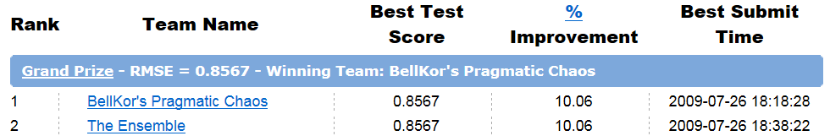
Netflix Prize
A public company providing DVD-rental service
Target:
To predict whether someone will enjoy a movie based on how much they liked or disliked other movies.
To improve the score of its own Cinematch by 10%
RMSE (Root Mean Squared Error)
Training Set:
<user, movie, date of grade, grade>
480,189 users, 17,770 movies,100,480,507 ratings

Slide 43


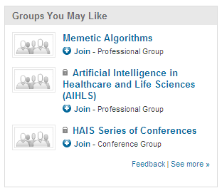
KDD Cup

Slide 44
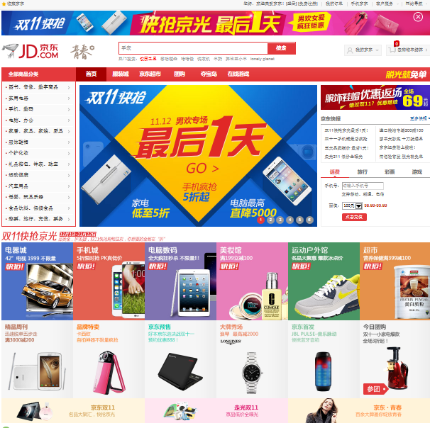
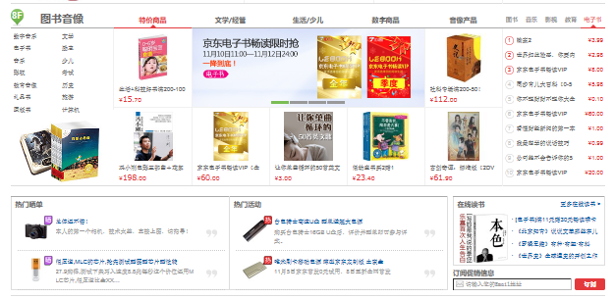
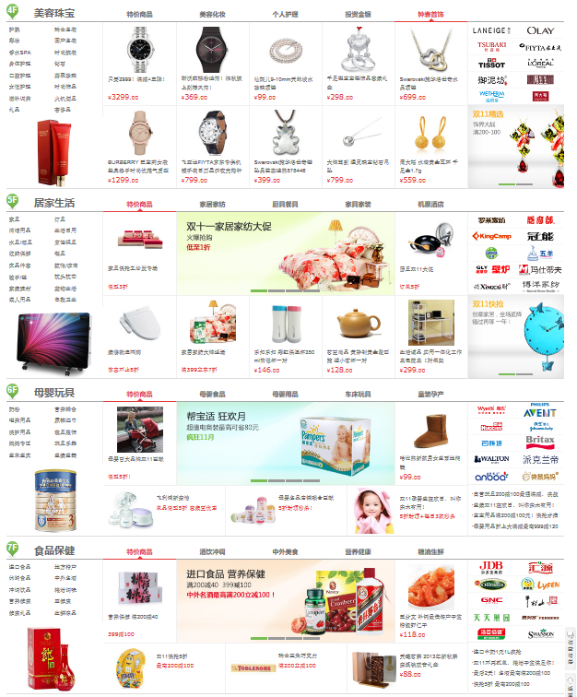


Slide 45







Slide 46





Slide 47


Slide 48




Reality Mining

Slide 49



Reality Mining

Slide 50








Slide 51


Open Questions
Customers are analyzed based solely on purchasing records.
More dimensions are to be added.
Just image how to recommend something to your friend …
People have different personalities.
Different strategies may be required.
Selling insurance: Emotional vs. Mature
People buy things for different reasons.
Impulse Buying vs. Planned Buying
Time Variant

Slide 52
Reading Materials
P. Resnick, N. Iacovou, M. Suchak, P. Bergstrom, and J. Riedl, “Grouplens: an Open Architecture for Collaborative Filtering of Netnews”, in Proceedings of the ACM Conference on Computer Supported Cooperative Work, pp. 175–186, 1994.
D. Billsus and M. Pazzani, “Learning Collaborative Information Filters”, in Proceedings of the 15th International Conference on Machine Learning, pp. 46-54, 1998.
B. Sarwar, G. Karypis, J. Konstan, and J. Riedl, “Item-Based Collaborative Filtering Recommendation Algorithms”, in Proceedings of the 10th international Conference on World Wide Web, pp. 285-295, 2001.
X. Su and T. Khoshgoftaar, “A Survey of Collaborative Filtering Techniques”, Advances in Artificial Intelligence, Article ID: 421425, 2009.
L. Page, S. Brin, R. Motwani, and T. Winograd, “The PageRank Citation Ranking: Bringing Order to the Web”, Technical Report, Stanford InfoLab, 1999.
S. Deerwester, S. Dumais, G. Furnas, T. Landauer, and R. Harshman, “Indexing by Latent Semantic Analysis”, JASIS, vol. 41(6), pp. 391-407, 1990.
E. Nathan and A. Pentland, “Reality Mining: Sensing Complex Social Systems”, Personal and Ubiquitous Computing, vol. 10(4), pp. 255-268, 2006.

